Slide 1
Topics to Discuss
What we are looking at automating:
Automation of setting up new safes from an end-user-requestable way. More insights into how other customers may have accomplished a self-service model would be ideal. We don’t have a very good Role definition at the company, so integrating this into something like IIQ is a future idea, but not realistic in the next several years.
We are also interested in incorporating updates to safes, vaulting additional accounts, adjusting permissions and are curious to hear how others have handled similar asks.
Additionally, we are interested in any insights in to ways other customers have used automation tools (ex. Ansible) for things like updating/maintaining/synchronizing/backing up configuration files.
Ways other customers have plugged in to build/onboarding processes for vaulting account types beyond Active Directory (for example, local SQL Server accounts or other databases)
Considerations for deploying the different PAS components to AWS. In particular: guidance on how to keep the AMI’s current (particularly the vault). I’m aware you have several documents / GitHub repos that discuss deploying Core PAS to the cloud, can you share any common pitfalls or things to consider should we move to deploying to the cloud?
Automation tools currently in use:
Currently we have/are finalizing automation for creating a new safe, creating Active Directory accounts and groups, and then vaulting the newly created accounts in to the newly created safe (along with triggering a reconcile on the accounts).
We use GitLab pages for the end user information gathering, a Jenkins pipeline to trigger some of our AD Object creation, and PowerShell, along with psPAS for the calls to the CyberArk RestAPI.

Slide 2
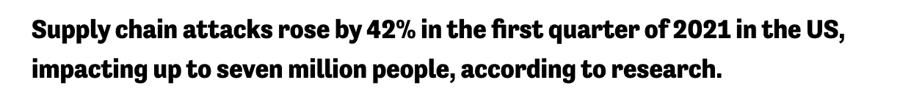

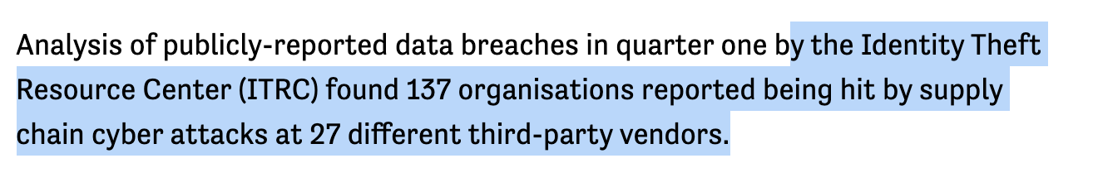
Secrets Management is more important than ever
Supply chain attack covers any instance where an attacker interferes with or hijacks software development lifecycle, This can happen when:
Code libraries being used in a software build are tainted.
Code-signing certificates are stolen.
when a server hosting software-as-a-service (SaaS) is compromised.

Slide 3
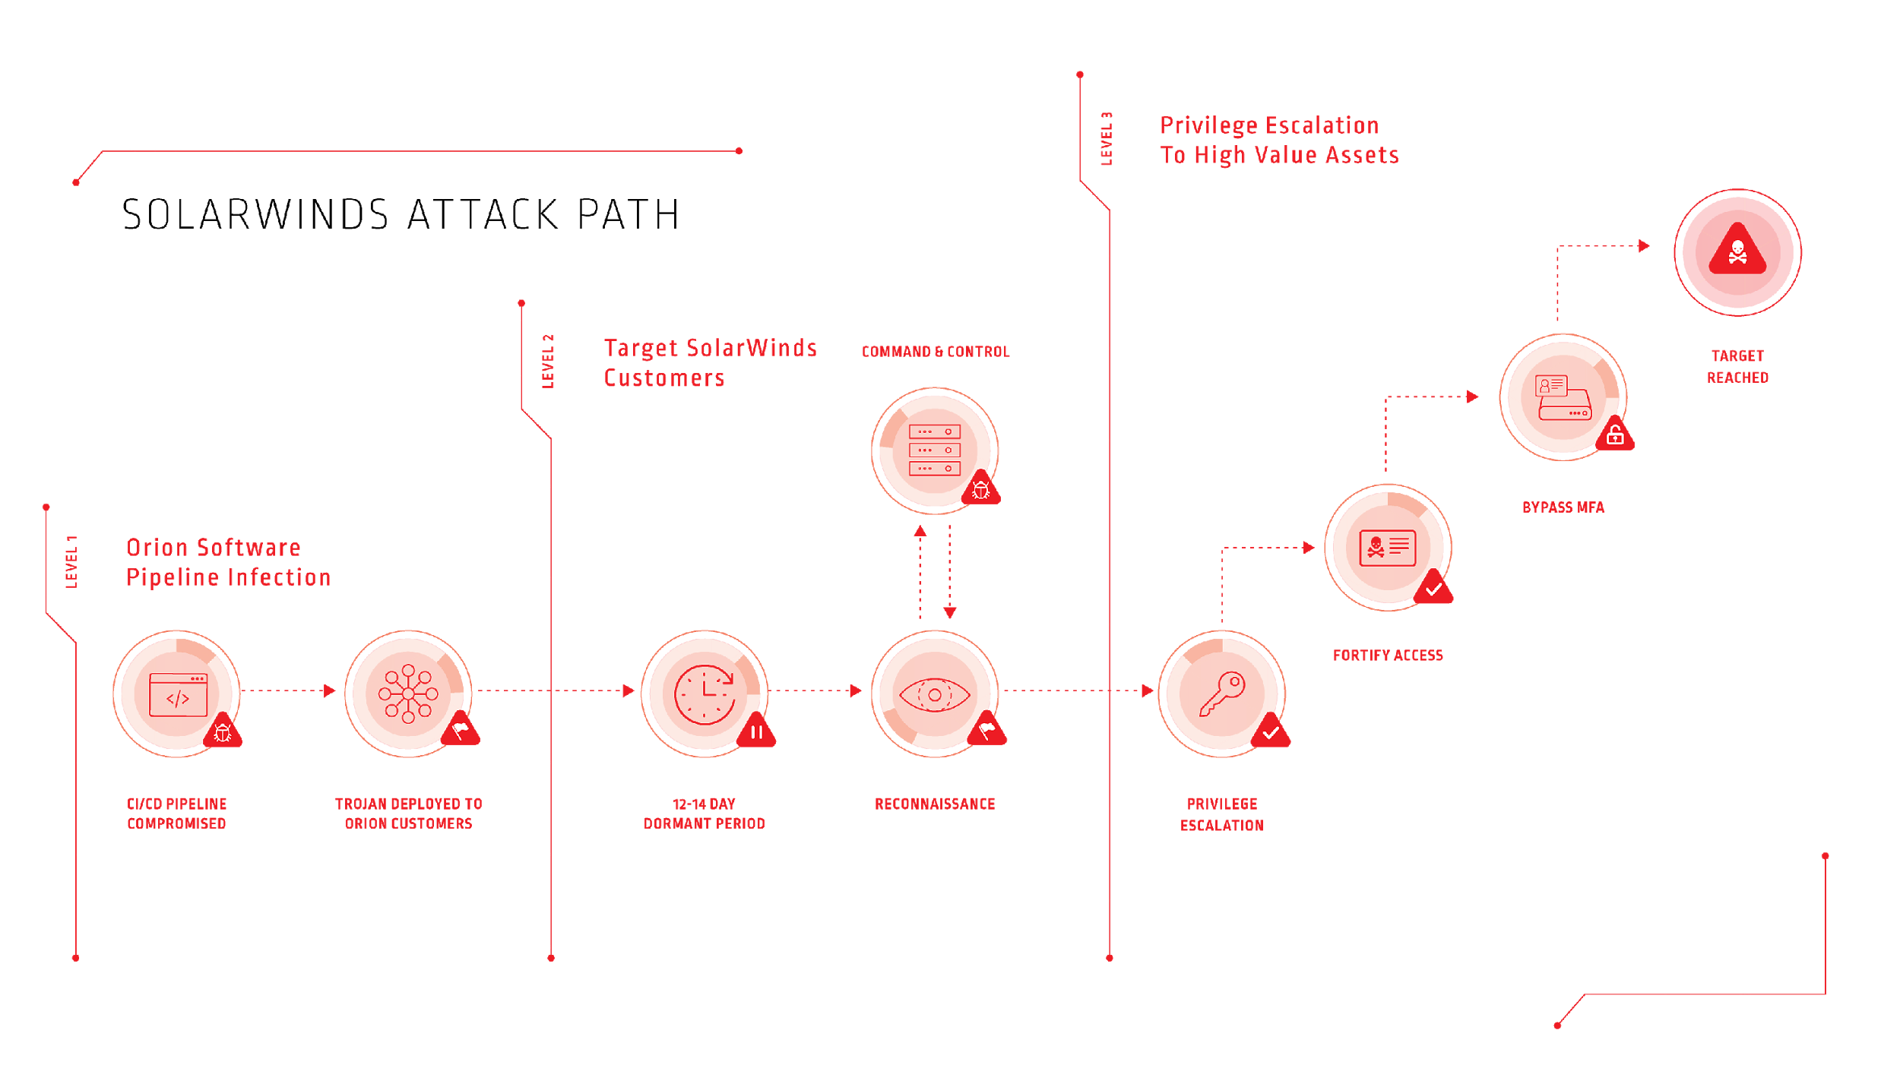
Solarwinds attack
Secrets Management helps here
Privileged Access Management helps here
Notes:
Apps are a new attack path (from last slide)
The Solarwinds attack started with a CI/CD compromise
GitHub
Even found a Fortune50 account myself

Slide 4
Cyberark Secrets Management
Centralized application access management at scale

Slide 5
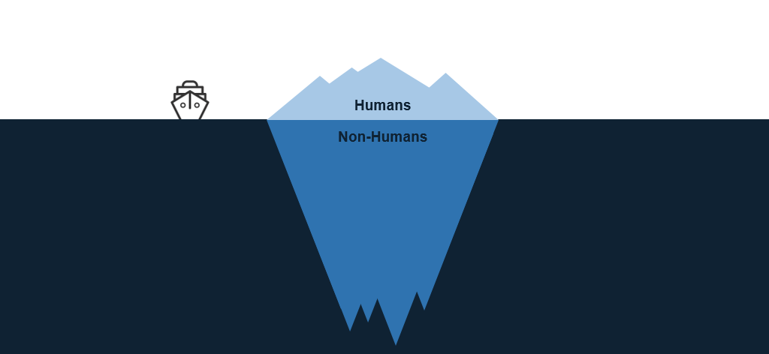
Human Access vs. Non-Human Access

Slide 6
Secrets management Operational objectives
Autonomy
Empower users
Efficiency
Automated (mostly)
Role Separation
Approvals
Account creation
Identity creation
Permission grants
Self-service
Secure
Scalable
Expeditious
Low-maintenance
Enable productivity
Delegate admin responsibilities

Slide 7
Abstract Workflow
Access request is submitted by Project
Access request is approved
Access request is processed
Access request status & results sent to Project
IGA/GRC forensics recorded throughout

Slide 8



Self-Serve Provisioning Architecture
CyberArk
Vault
1) Get admin creds w/ CP/CCP
Orchestration
Provisioning Engine
User submits access request
2) PVWA REST Calls
Feedback Channel
Provisioning Engine options:
Service-Now
IGA Solution (Sailpoint, ForgeRock, Savyint, RSA, etc.)
Clango Embark
Refactr workflow
DevOps automation (Ansible, Jenkins, etc.)
Custom application (Java, .Net, Go, etc.)
Scripts
anything that can make REST calls
3) Conjur REST Calls

Slide 9



Separation of Concerns
CyberArk
Vault
Security Admins
Secrets mgmt
Creation
Rotation
Rotation Protocols
CyberArk
Secrets Management
Target Systems
Databases
Servers
Network Equipment
Project Admins
App policies
Identities
Permissions
Access Protocols
Source Code Mgmt
CI-CD Tools / Applications
App Devs

Slide 10
Oversight should increase closer to production
Access Provisioning triggered automatically
Secrets could be managed by DevOps Teams
Access Provisioning requires approvals
Secrets managed by the Security team
Dev
Test
Prod

Slide 11
Guidelines
99.999% of secrets access is read-only
A “Project”:
Is an operational group of humans (app team, CI/CD admin group)
PLUS:
The apps they build and deploy
Associated CI/CD processes
Associated deployment platform resources (servers, k8s clusters, cloud accounts)
All associated credentials/secrets.
Corresponds to one or more Safes in the CyberArk Vault
Scopes non-human identities (all non-human identities belong to a project)
Has a designated person and/or process acting in a Project admin role.
Vault Safes are ALWAYS and ONLY EVER created by Vault admin processes.
Only Vault or Project admin processes have CRUD privileges on secrets.
CI/CD tools & deployed apps can only read secrets.

Slide 12
Three operational reference models
Synced to Conjur
Only in core Vault
Security-Owned
Collaborative
Project-Owned
SecretsSafe
AdminSafe
DBA creds
API keys
Certs
SecretsSafe
AdminSafe
DBA creds
API keys
Certs
SecretsSafe
AdminSafe (not synced)
DBA creds
API keys
Certs
Security provisions everything
Gives Project team names of identities, Conjur variables.
Credentials for Identity authentication are stored in AdminSafe for Project Admin to distribute.
Example: Big US insurance co.
Security provisions safes & accounts, grants limited safe admin creds to Project Admin role
Project Admin role creates app identities & grants permissions to Conjur hosts/groups
Project Admin role stores identity authn creds in AdminSafe
Example: CYBR PS team
Security only provisions safes, grants safe admin creds to Project Admin role
Project Admin role provisions accounts, creates app identities & grants permissions to Conjur hosts/groups
Project Admin role stores identity authn creds in AdminSafe
Example: Big Euro bank

Slide 13
Customer Examples

Slide 14
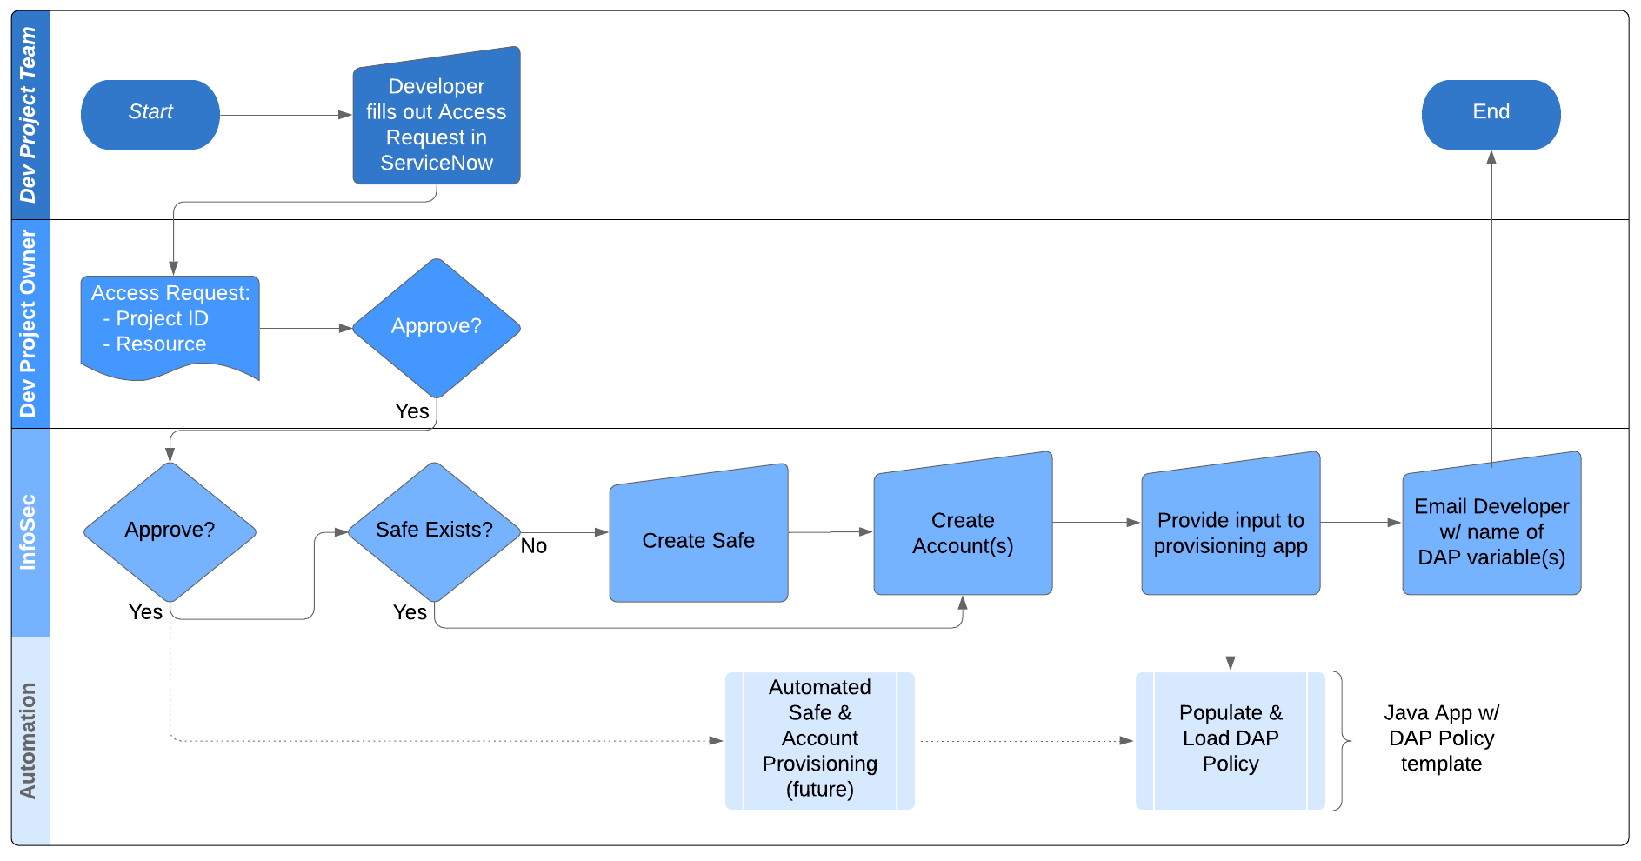
Big insurance company: OpenShift app access workflow

Slide 15
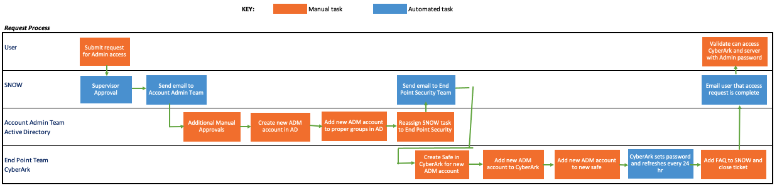
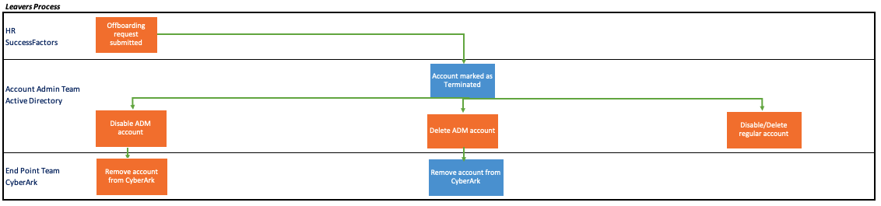
Manufacturing Company

Slide 16
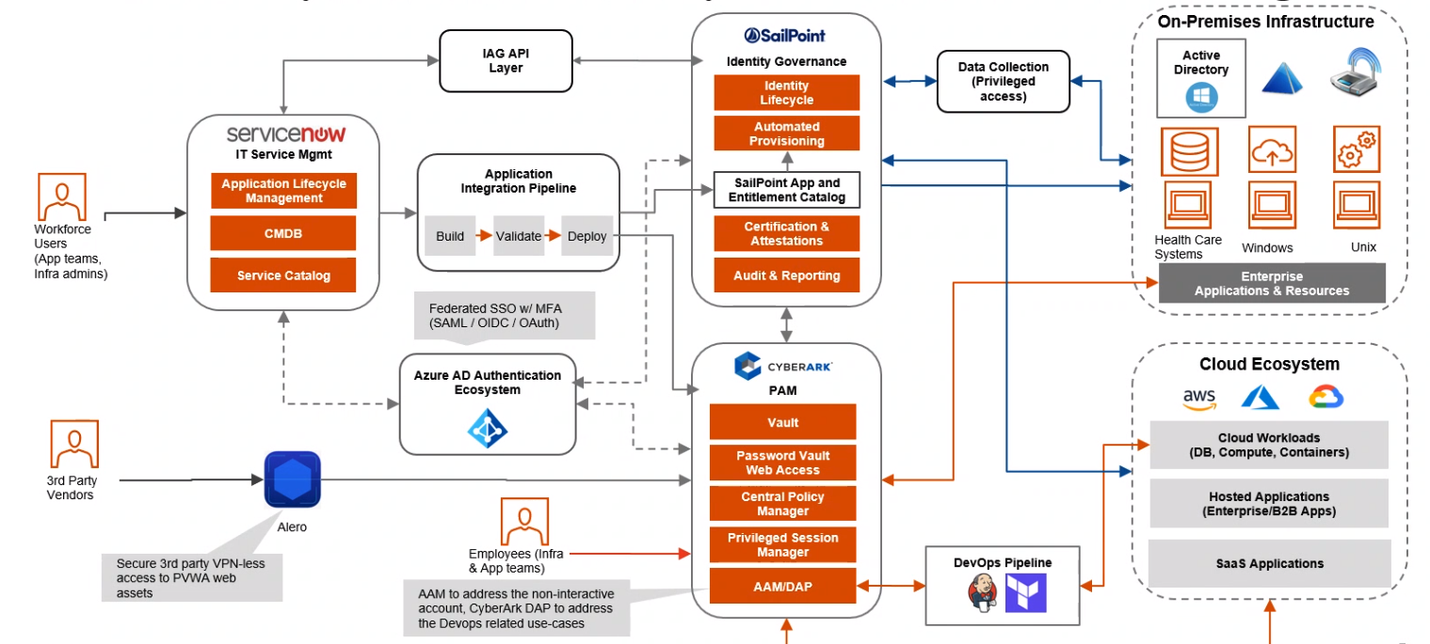
Healthcare provider: High-level architecture

Slide 17
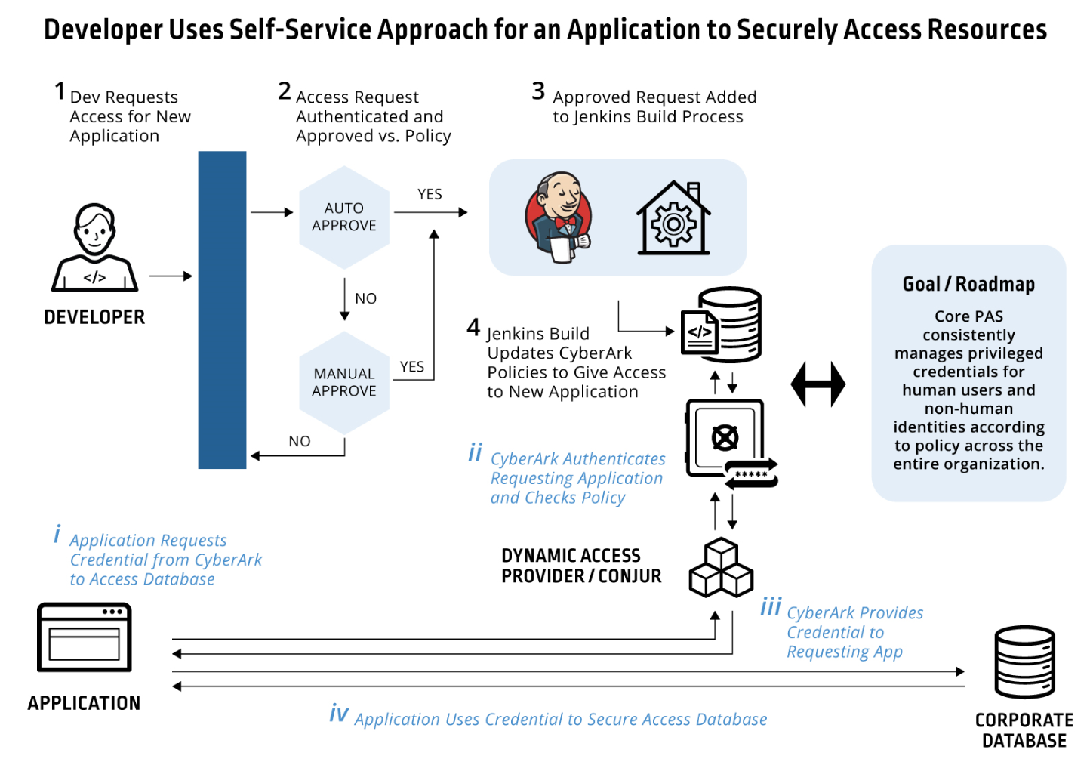

Leading Big Box Retailer
Security works with developers on self-service for secure app access to databases
Objective
Shrink attack surface and meet rigorous audit requirements imposed after prior breach
Establish an enterprise-wide solution for human and non-human credentials
Enable lean security team’s approval process to scale for thousands of developers
Approach
Enable self-service provisioning for typical requests and route exceptions to the security team.
Automatically update secrets manager policies to give apps secure access to resources
Leverage PAM to protect human credentials
Result/Outcome
Successfully rolling out across org.
CONJUR SECRETS
MANAGER
Notes:
This customer, a leading retailer wanted developers to easily allow their in-house developed applications to securely access to databases and other protected resources.
Security was a critical priority for this customer, a few years earlier the company had suffered a breach and had since worked to shrink the attack surface and impose rigorous audit and security requirements. But, rapidly getting new functions and apps deployed to thousands of stores was also critical as the business operated in a highly competitive market. So while the security team obviously wanted to avoid developers hardcoding credentials in apps or using other in-secure practices, at the same time the security team recognized that the business could not afford to slow down deployment of new retail apps and services.
Scale was also a major challenge facing the security team – the organization had thousands of developers and a very small security team. The security team recognized it was essential that any approval process did not become a roadblock for developers.
So the security team established a self-service solution which automated approval requests from developers and only routed exceptions to the security team. Developers simply request approval for the application to access specific databases. Once approved the system, uses a Jenkins build pipeline to automatically update the AAM DAP policy files. So now when applications request credentials from DAP to access the requested resource, the request is approved based on the updated DAP policy.
The solution went into production in 2019 and is being scaled to handle the thousands of applications used by the retailer.

Slide 18
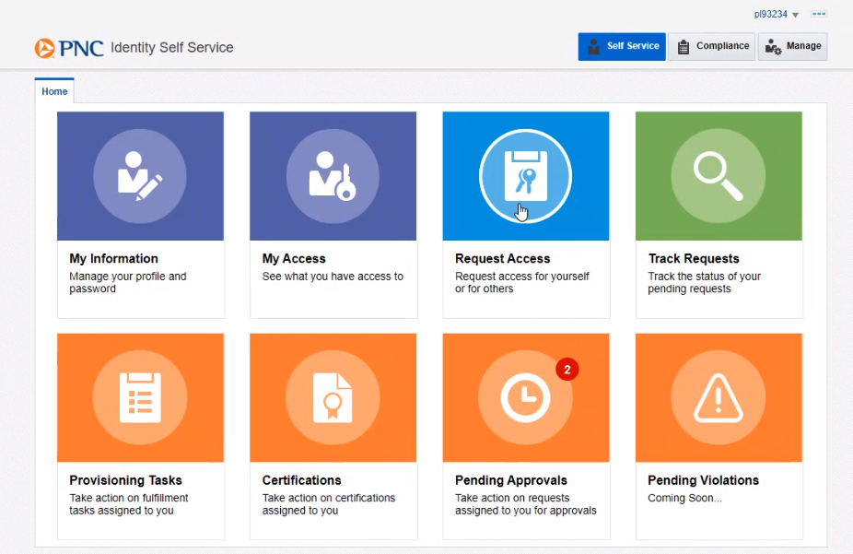
Large bank: Self Service Portal

Slide 19
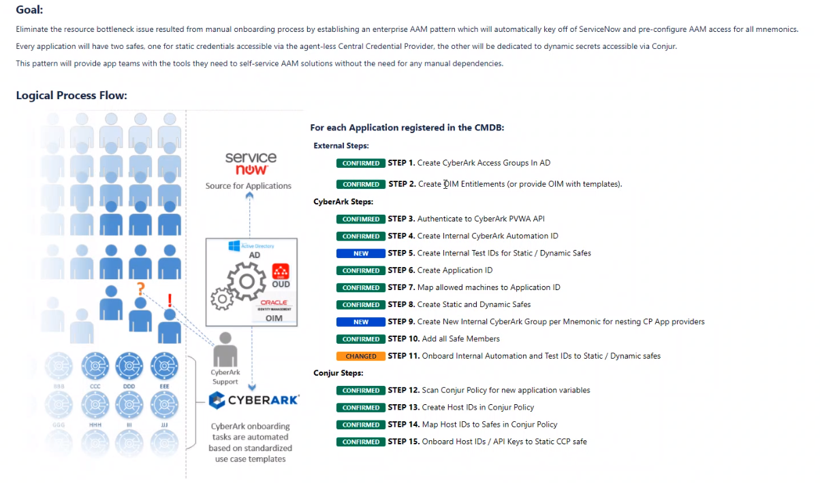
Large bank: Solution Overview

Slide 20
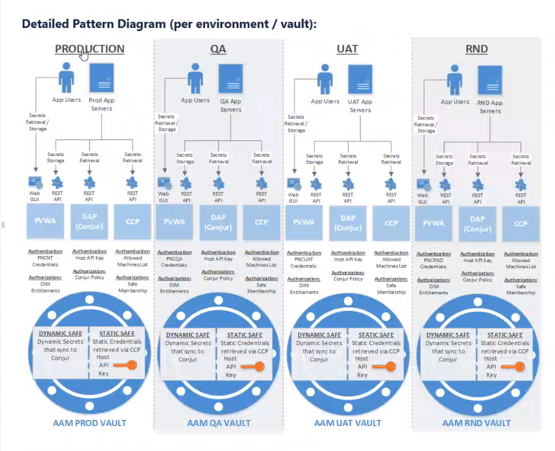
Large bank: A vault for each environment

Slide 21
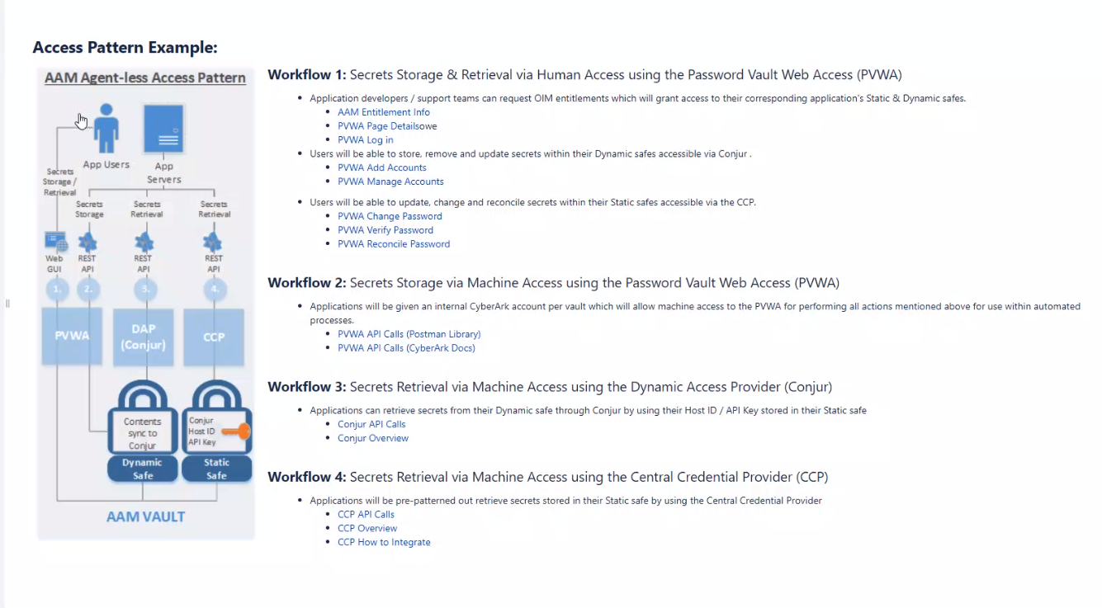
Large bank: Workflows

Slide 22
Demo

Slide 23
Solution values
Code
CI/CD
Production
On prem or cloud
Easy to use
Open RestAPI
Transparent to apps
Out of the box plugins
Jenkins,
GitLab,
Ansible,
Terraform,
and more ….
Cloud authenticators
Autoscaling/HA solution
Native integrations with K8s and OpenShift
Self service automation
Value to the organization:
Efficiency – Rapid access provisioning
Minimal code changes required
Consistent with cloud user experience
Separates concerns – DevOps vs. Security
Meets security compliance requirements

Slide 24
Thank you!

